Slide 1


In-house Developments
IN-HOUSE DEVELOPMENT PROJECTS
STATUS REPORT

Slide 2
GSD Ticketing System
Progress Report
Oct 12, 2023

Slide 3
GSD Ticketing System
Task | Details | Problem Encountered | Solution | Status
Dashboard | Exclusive dashboard for GSD ticketing system integrated in CHASE | Need planning and requirements |  | Not final
Request Creation | Create form using different forms depending on the request type |  |  | Not final
Categories Maintenance | View, add, edit and delete categories |  |  | Not final
Request Type Maintenance | View, add, edit and delete request type Can use different types of form |  |  | Not final
Workflow Steps | Add, edit, view and delete workflow steps. |  |  | Not final

Slide 4
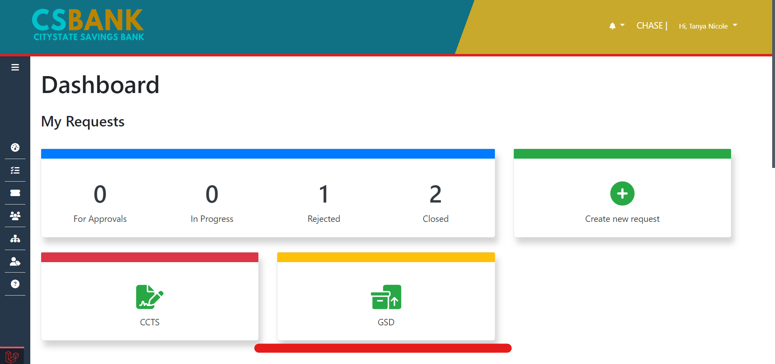
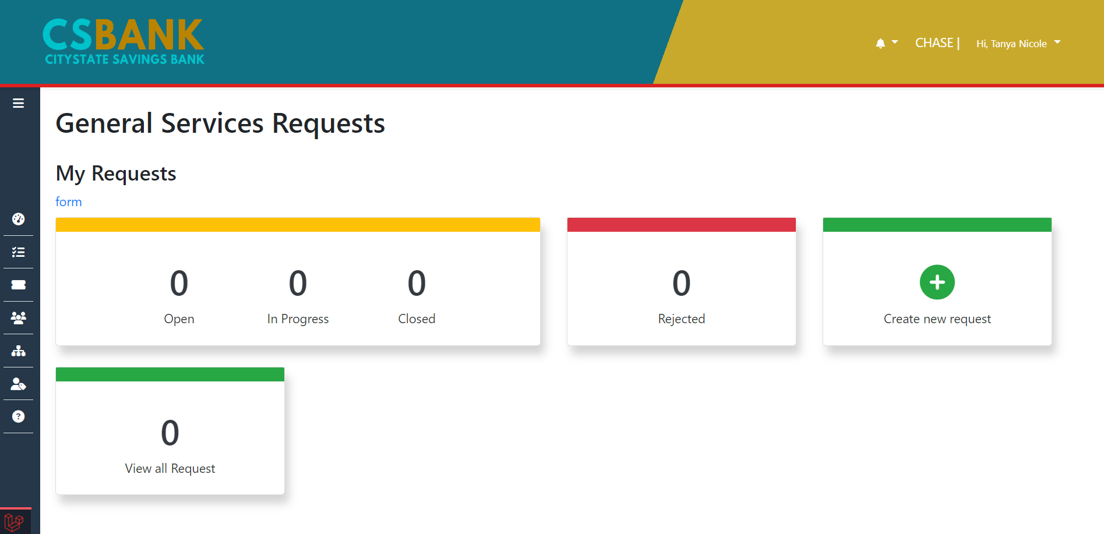
Dashboard
Exclusive dashboard for GSD ticketing system integrated in CHASE

Slide 5
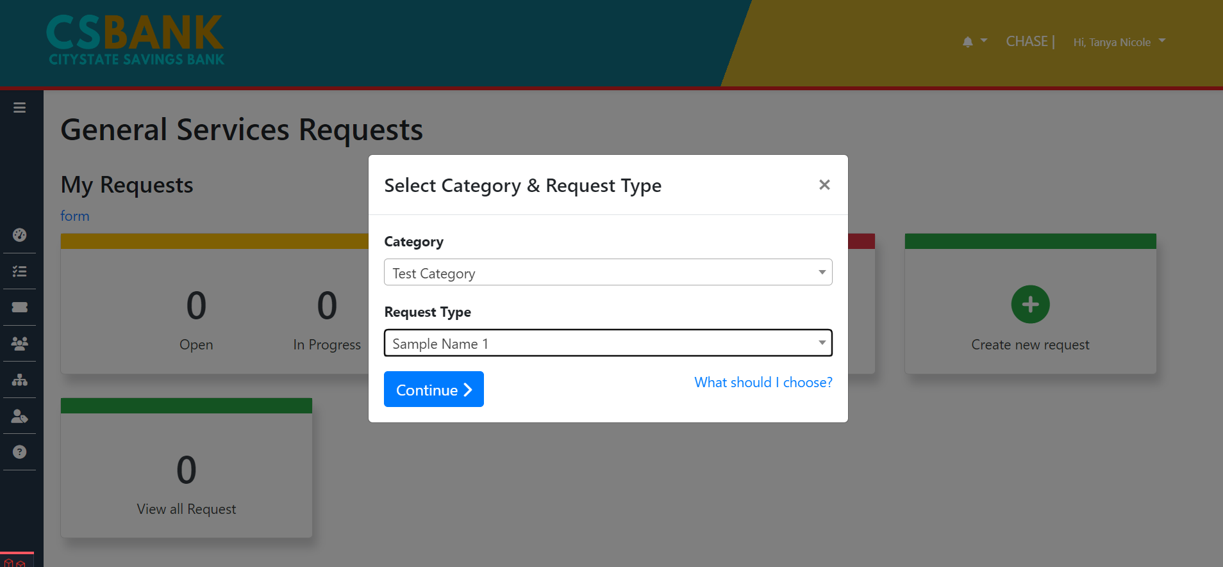
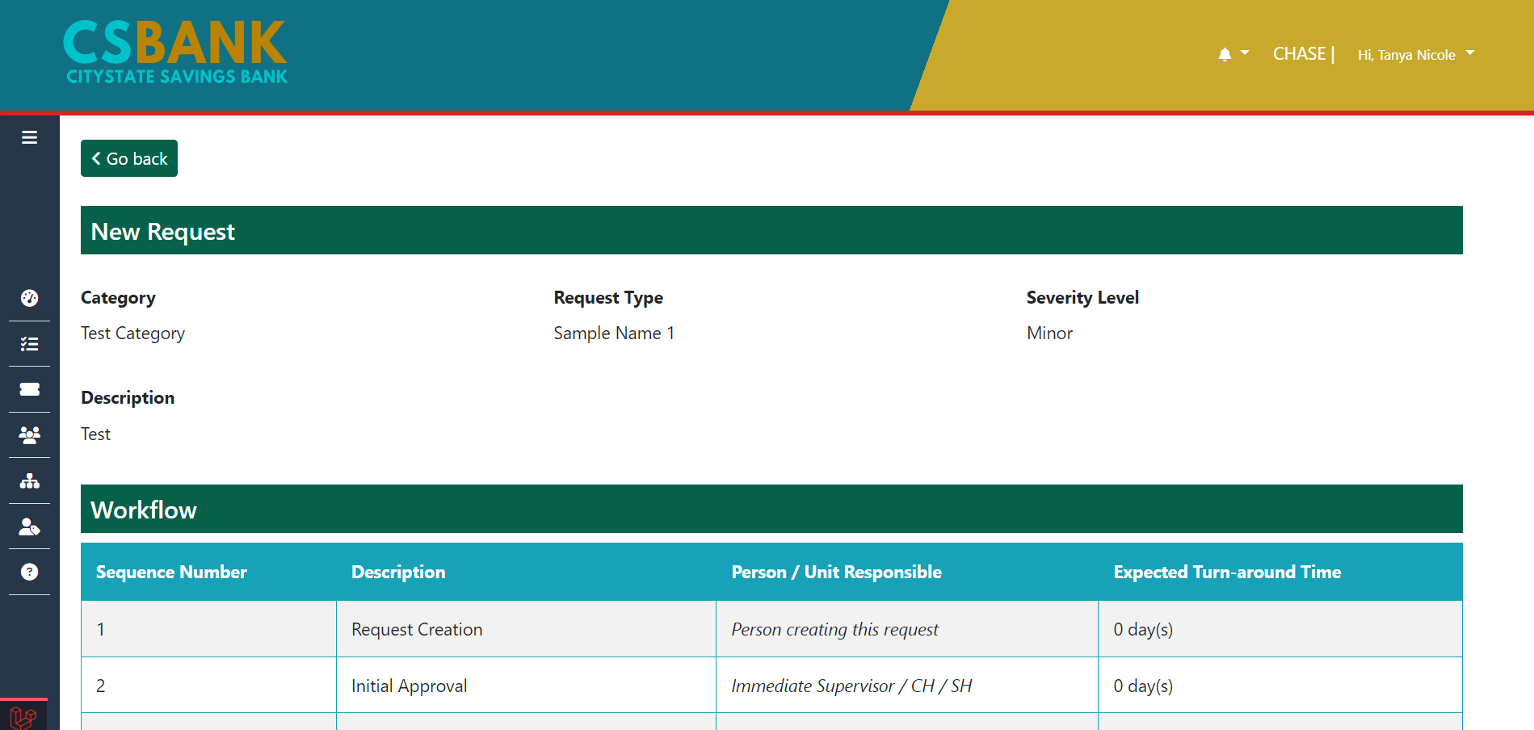
Request Creation using Regular CHASE form

Slide 6
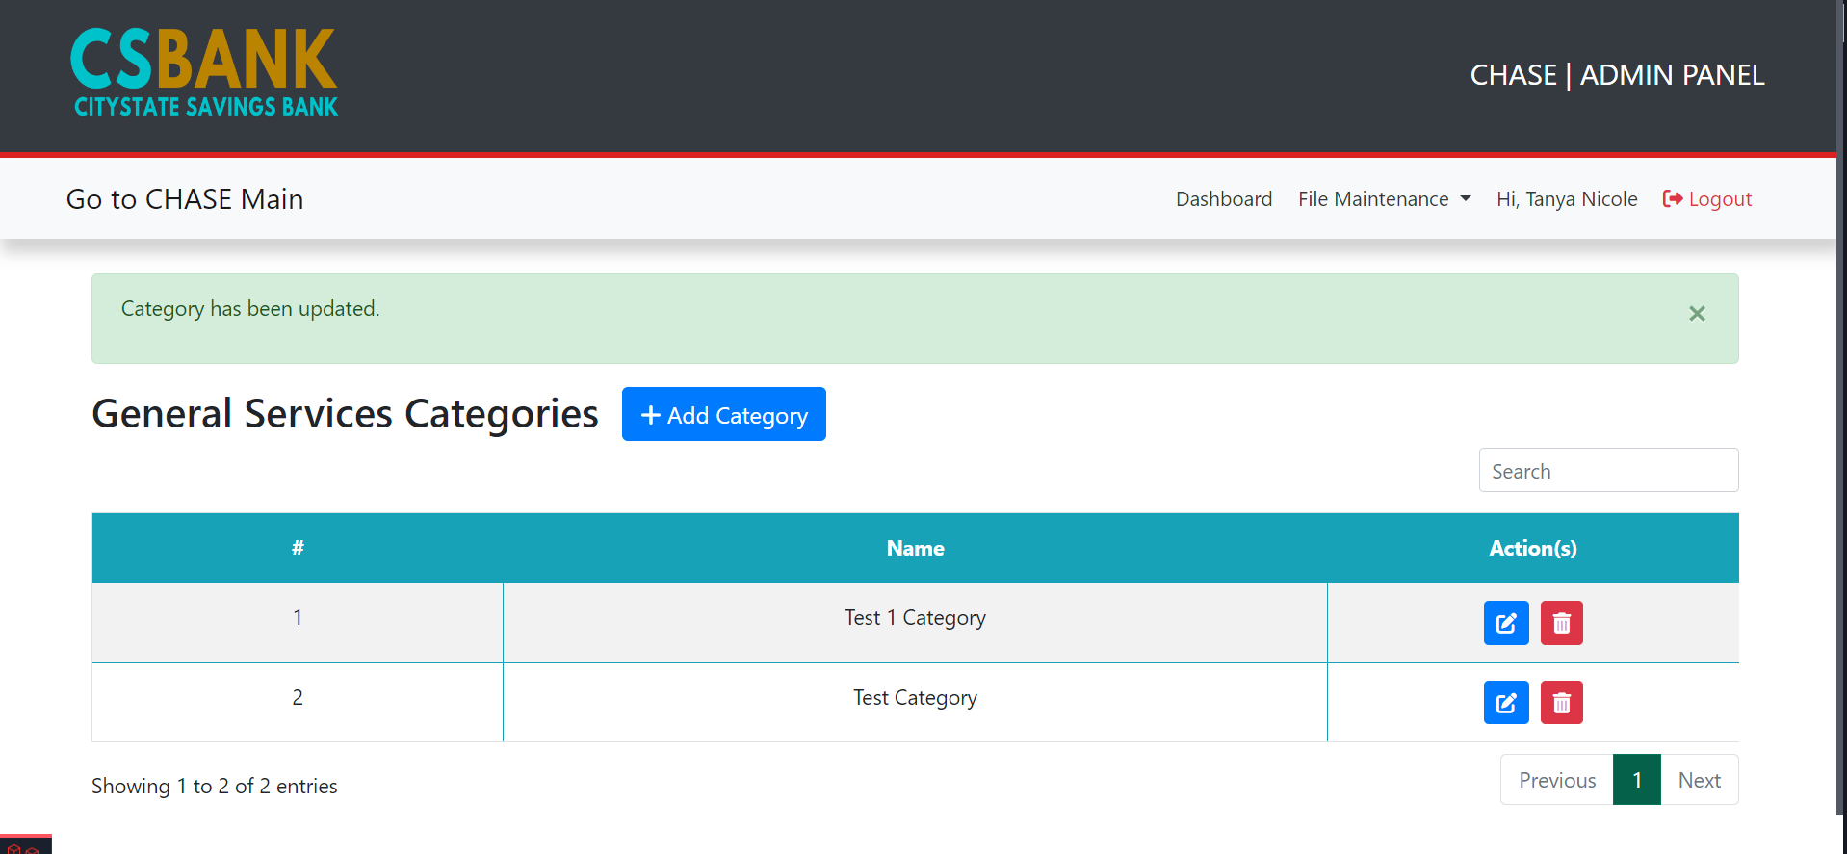
Category Maintenance
Admin can view, add, edit and delete GSD categories

Slide 7
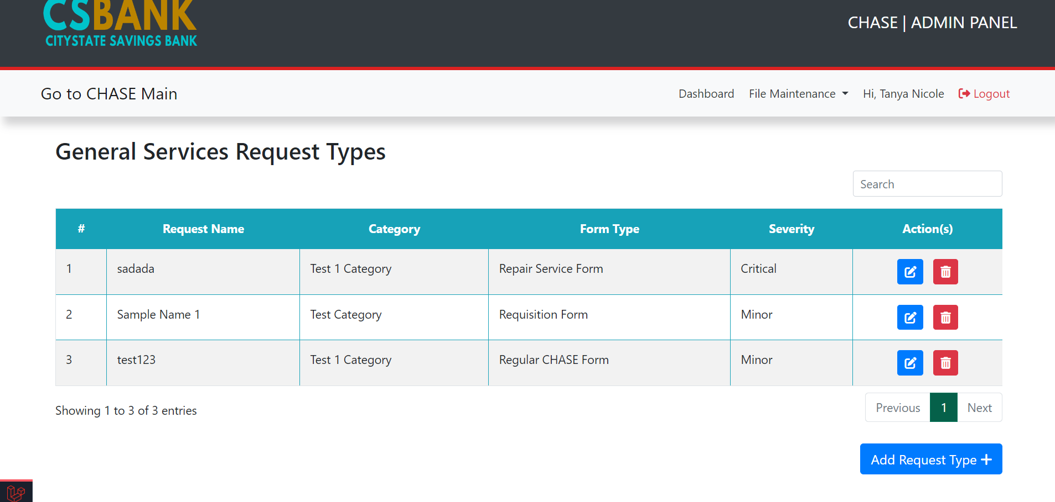
Request Types Maintenance
Admin can view, add, edit and delete GSD request types

Slide 8
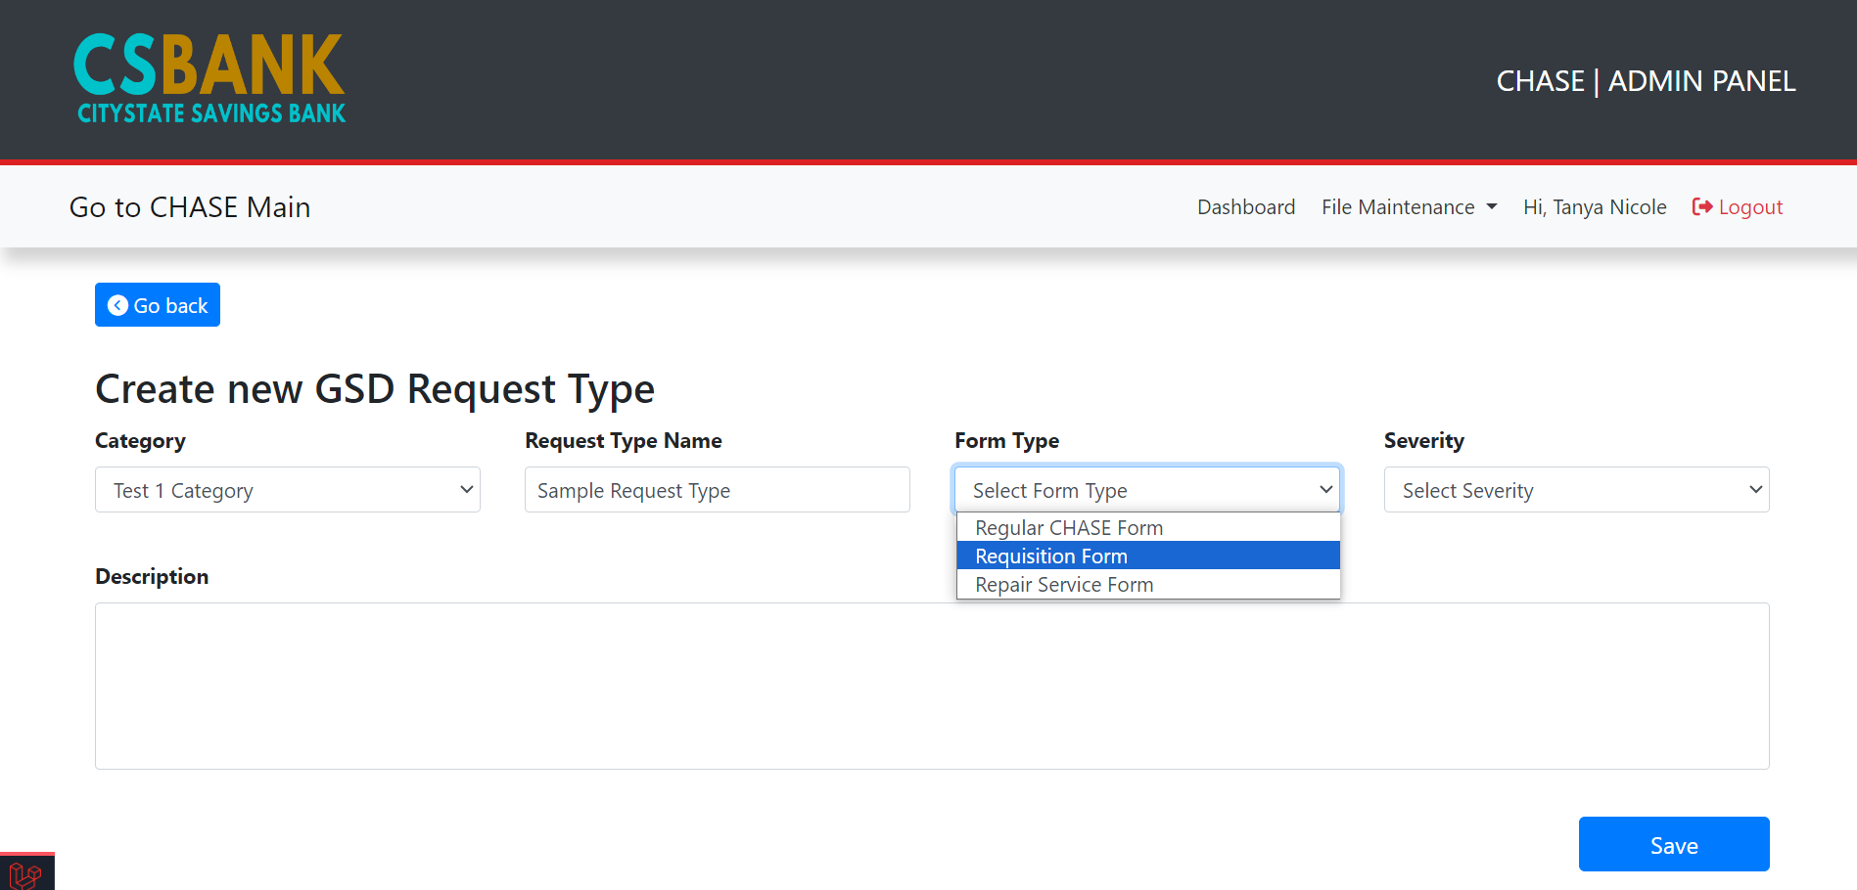
Request Types Creation
Different forms will be available.
Ex.
Requisition form
Repair Service form
Etc.

Slide 9
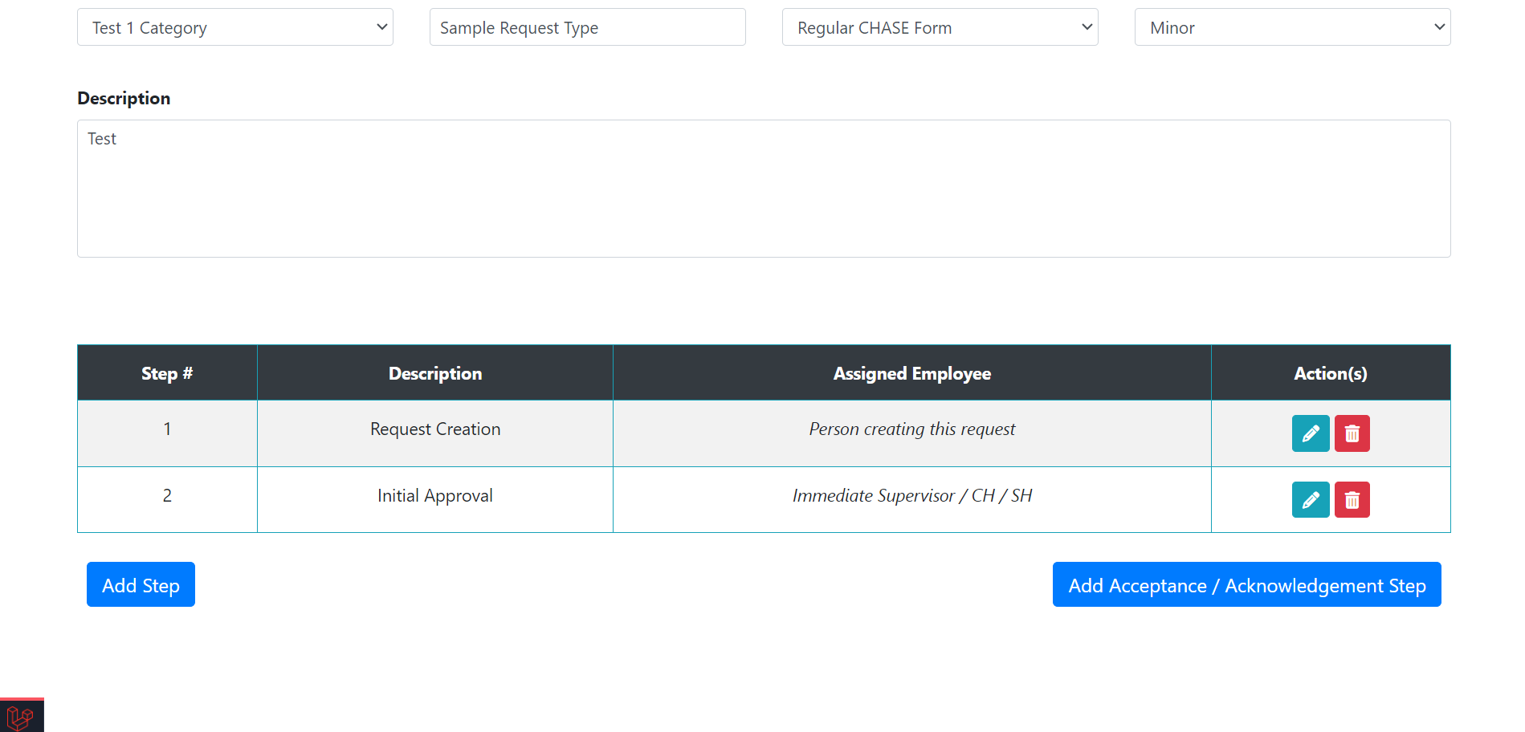
Request Types Creation
Once request type is created, workflow steps will be available.

Slide 10
Training Management System
Progress Report
Oct 12, 2023

Slide 11

Project Summary – CSBI Training Management System
Features | Details | Status
User Authentication | Allows users to log in securely. | Done

Slide 12
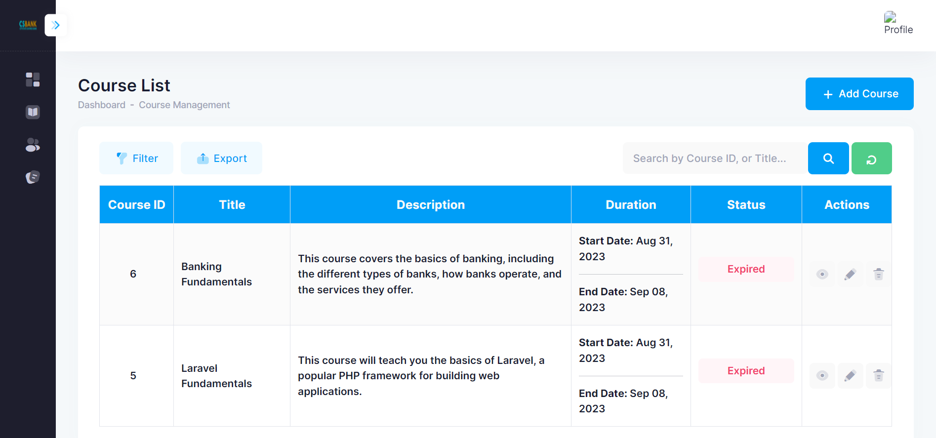
Features | Details | Status
Course Creation and Management | Admins can add, edit, and delete courses. Users can enroll in courses. | Done

Slide 13
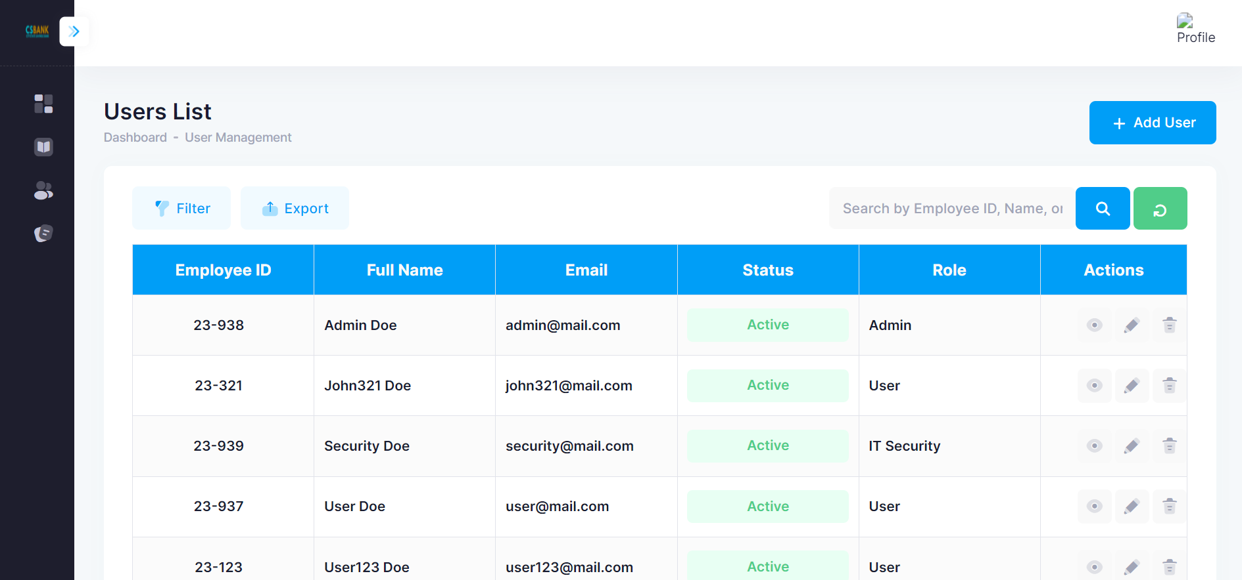
Features | Details | Status
User Creation and Management | Admins can add, edit, and delete users. | Done

Slide 14
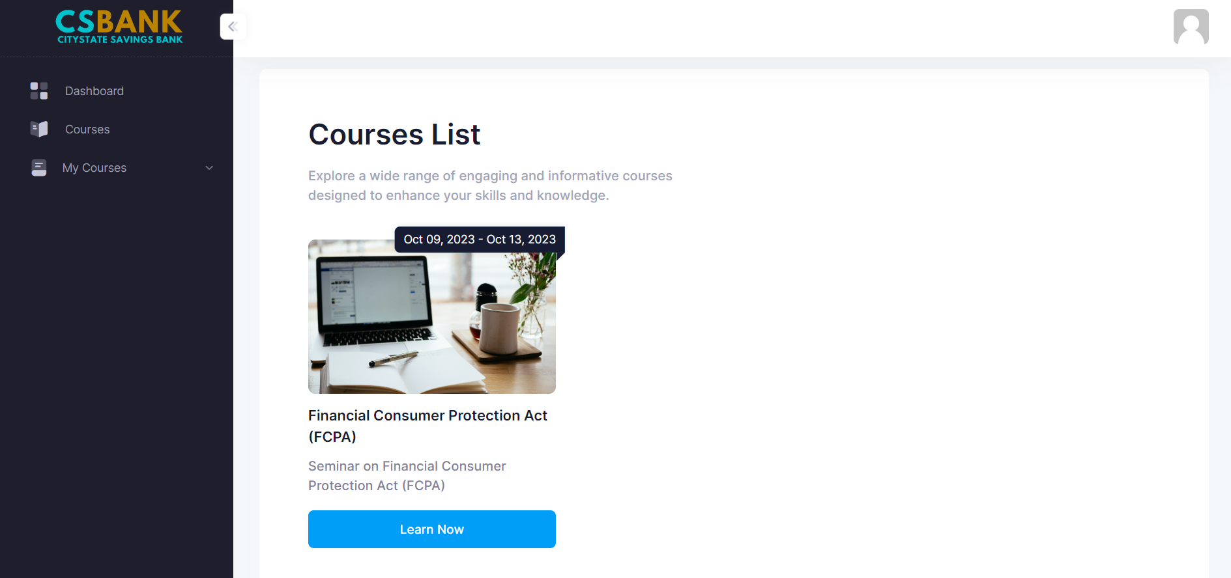
Features | Details | Status
Course List | Browse a comprehensive list of available courses with detailed description | Done

Slide 15

Features | Details | Status
Course Material Access | This feature allows enrolled users to access the learning materials such as videos associated with the course they have enrolled in. | Done

Slide 16
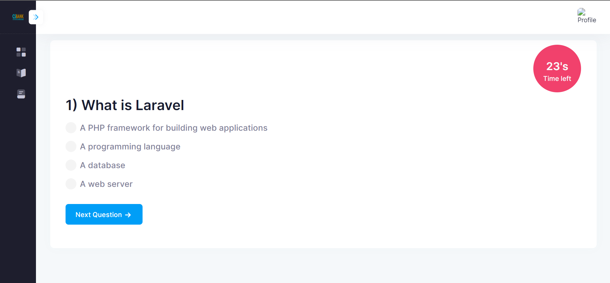
Features | Details | Status
Interactive Exam | Include interactive exam for effective learning. | Done

Slide 17
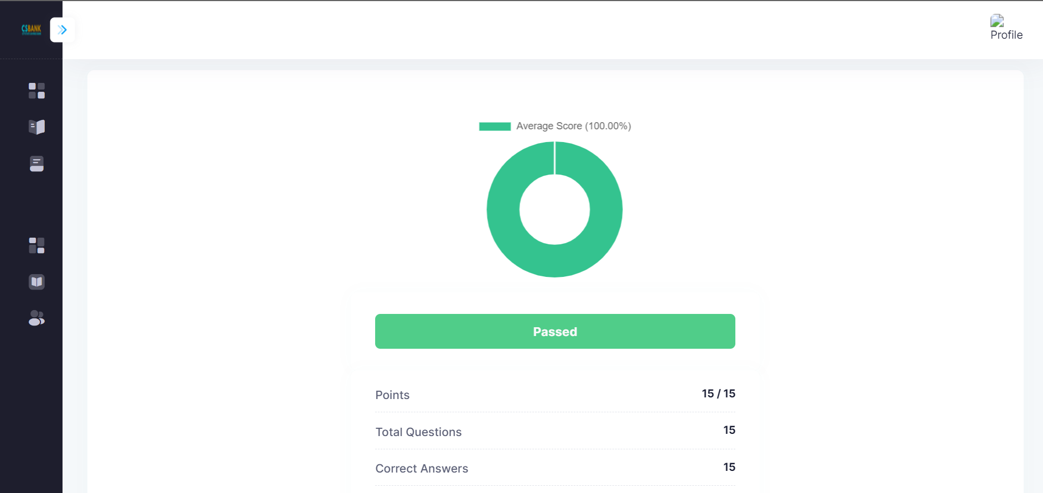
Features | Details | Status
Exam Result | This feature allows users to view their average score. | Done

Slide 18
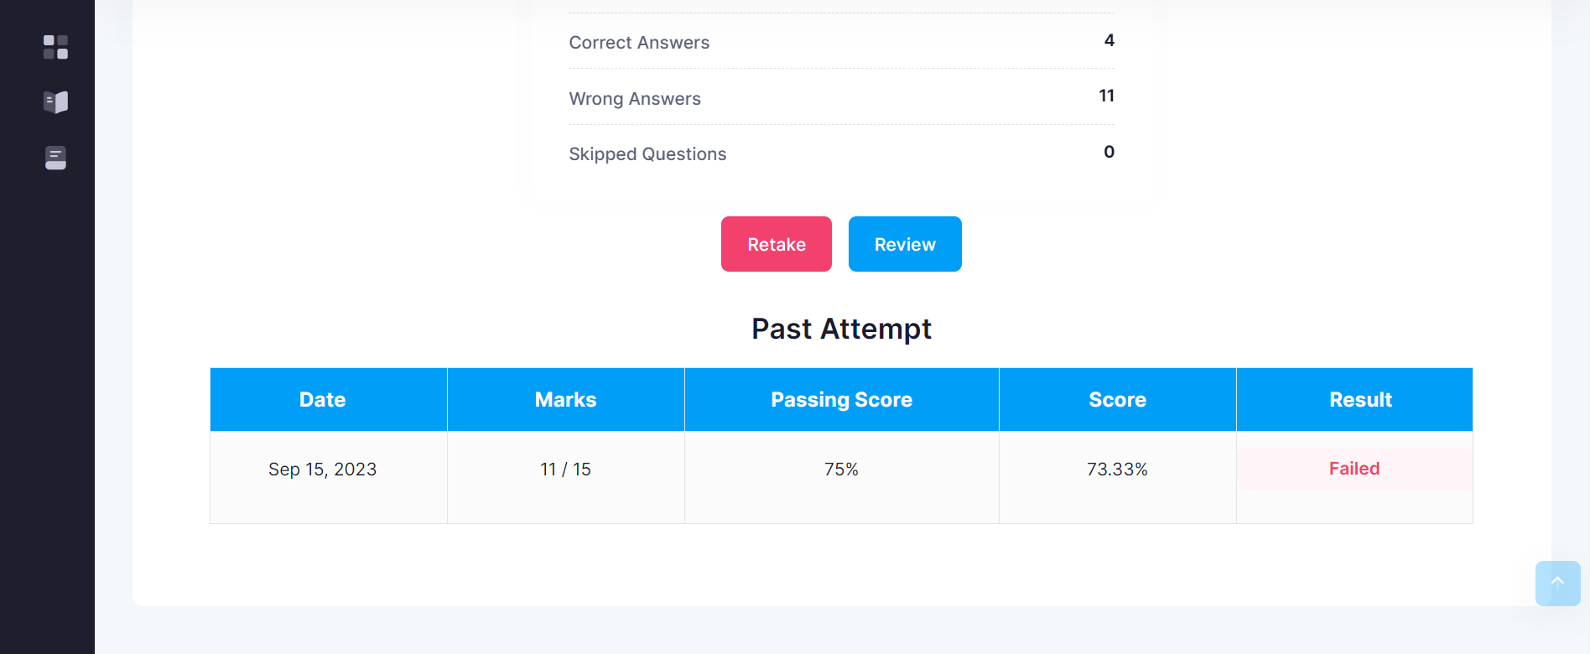
Features | Details | Status
Exam Review | This feature allows users to view their exam answers. | Done

Slide 19
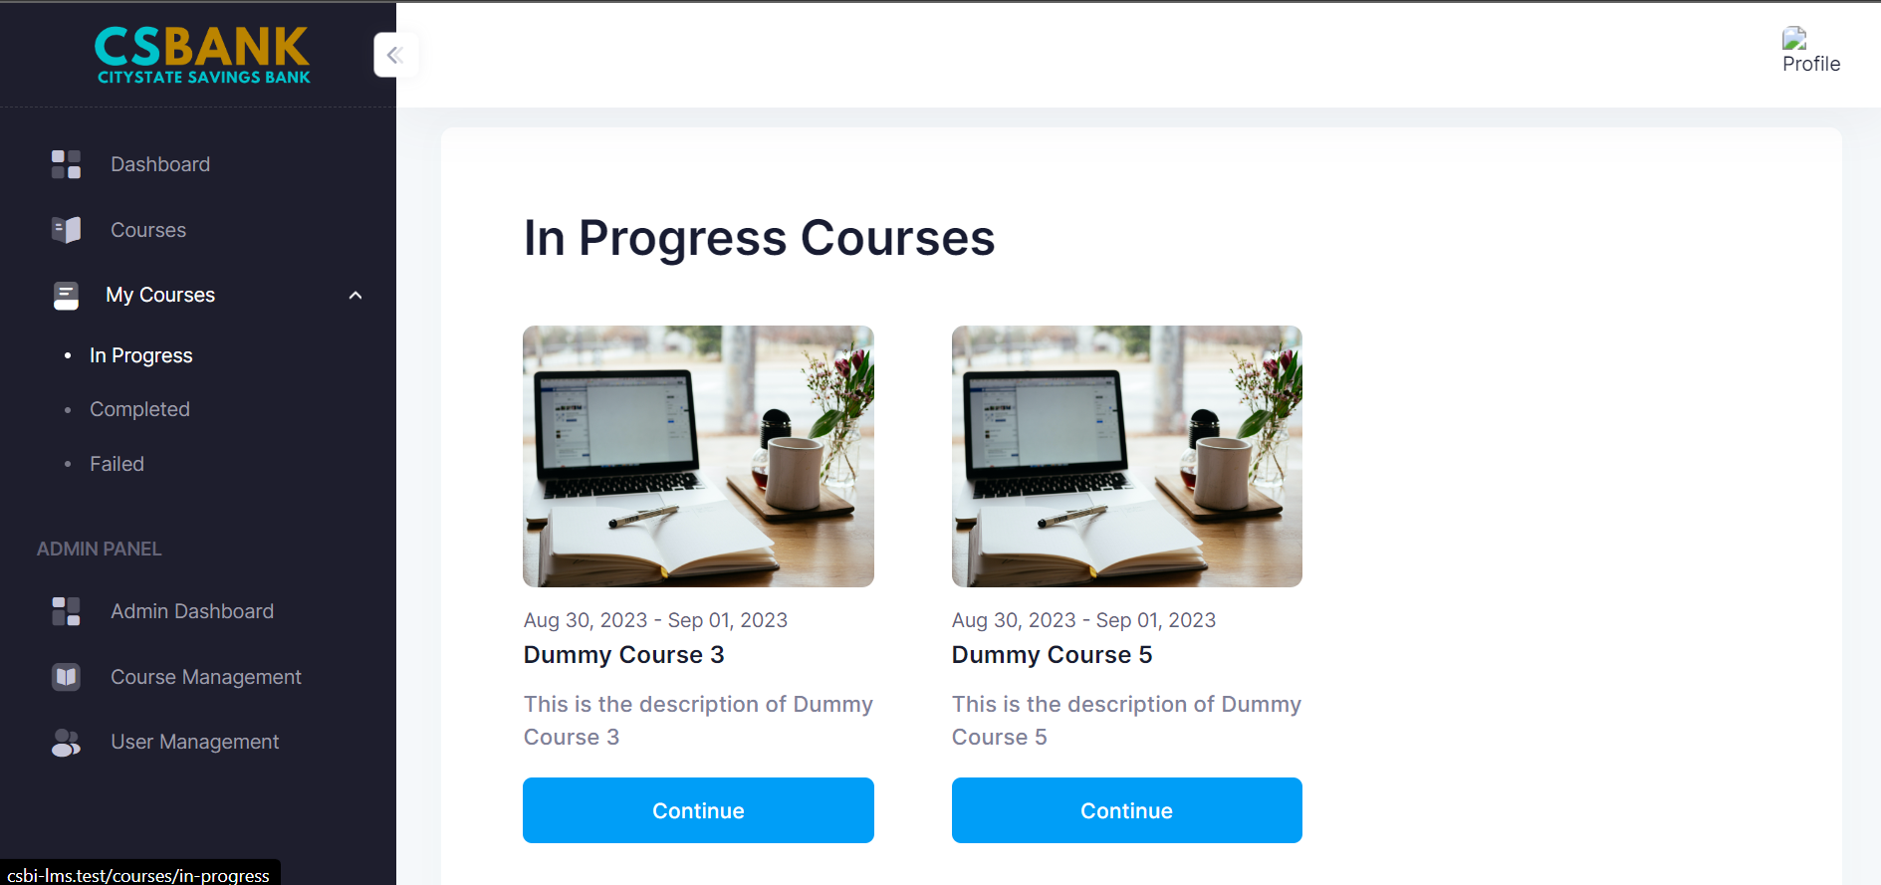
Features | Details | Status
Progress Tracking (In Progress Courses) | Users can monitor their progress and performance within each course. | Done

Slide 20
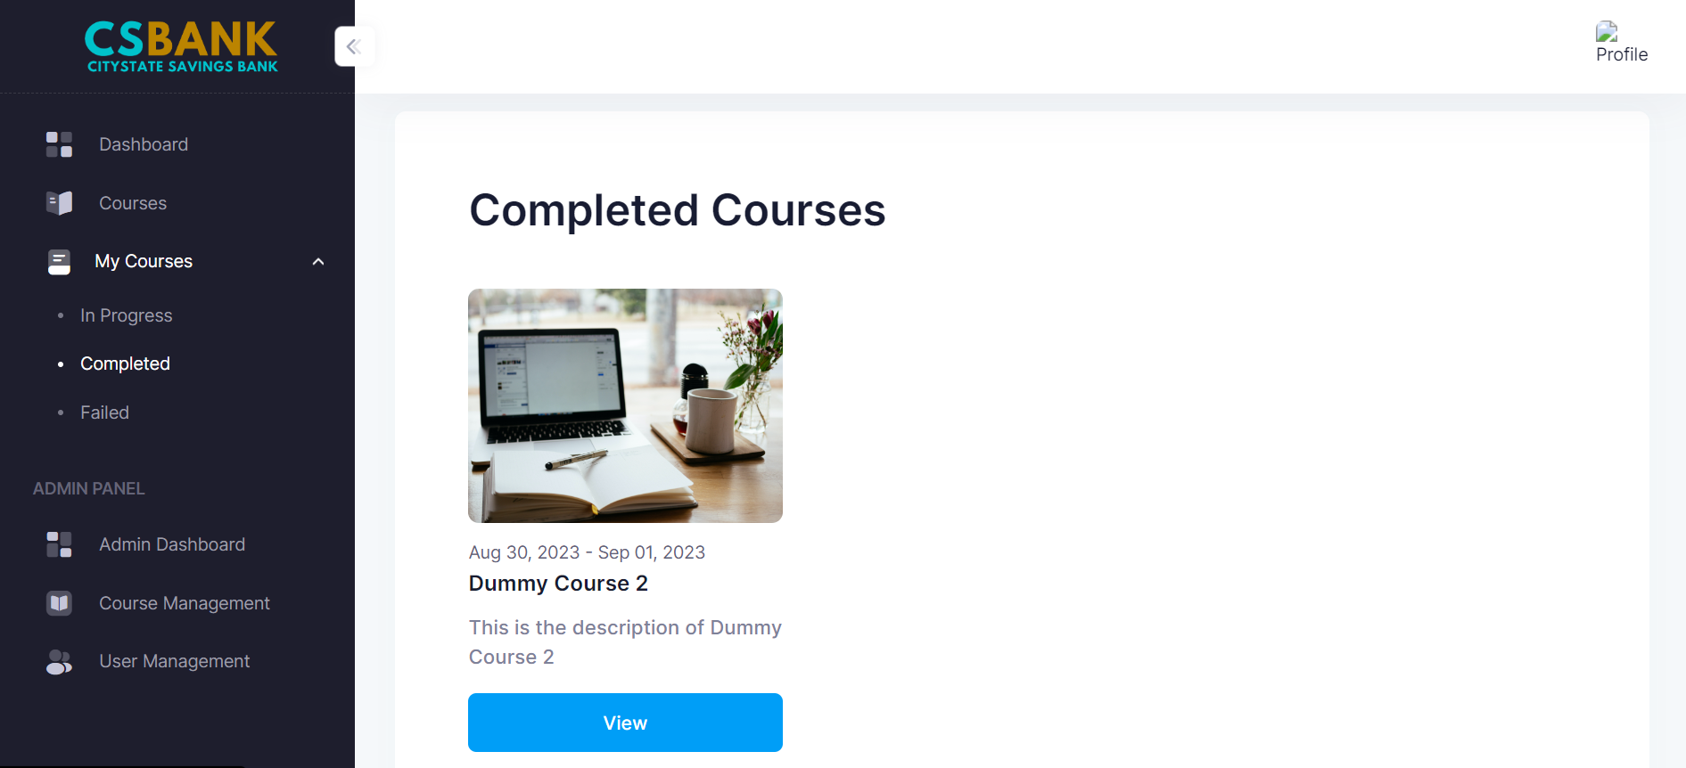
Features | Details | Status
Progress Tracking (Completed Courses) | Users can monitor their progress and performance within each course. | Done

Slide 21
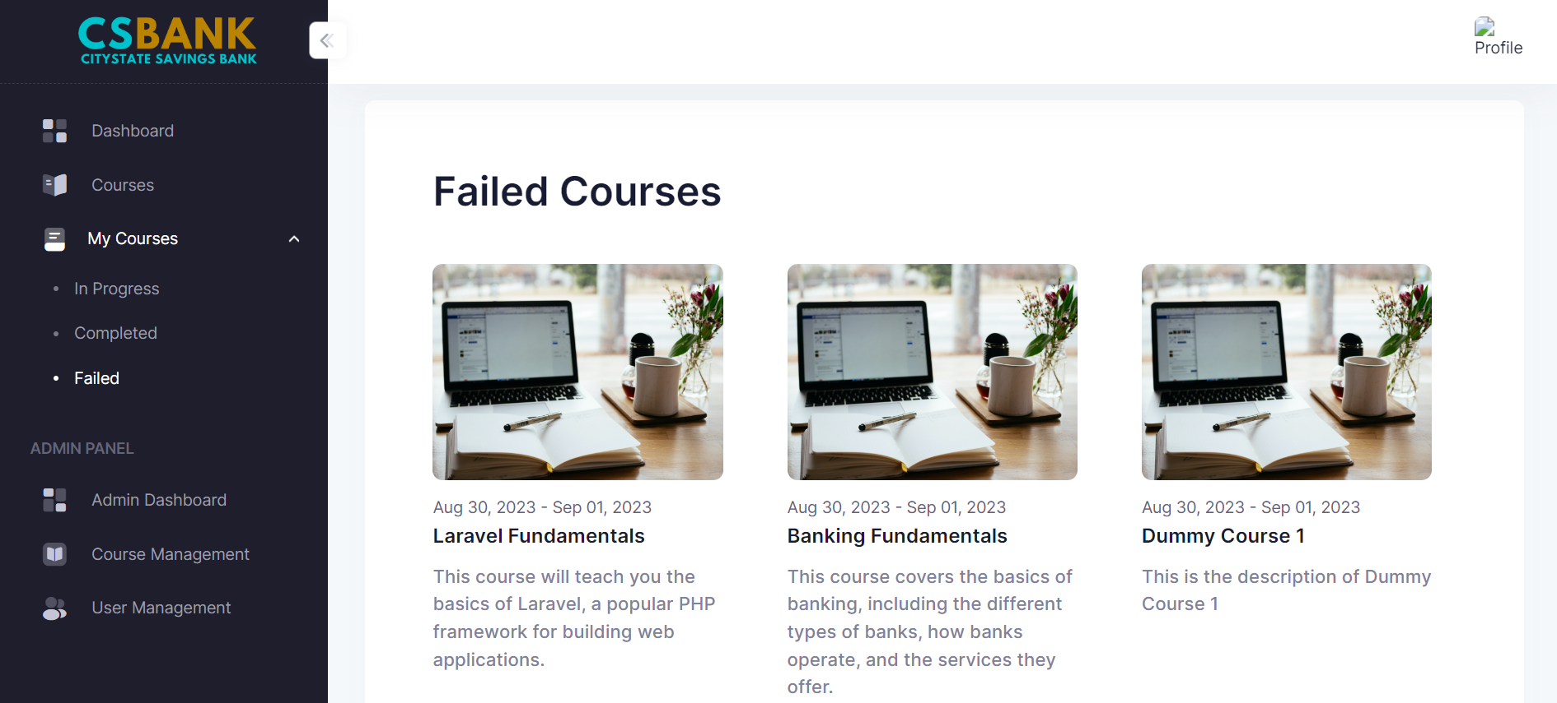
Features | Details | Status
Progress Tracking (Failed Courses) | Users can monitor their progress and performance within each course. | Done

Slide 22
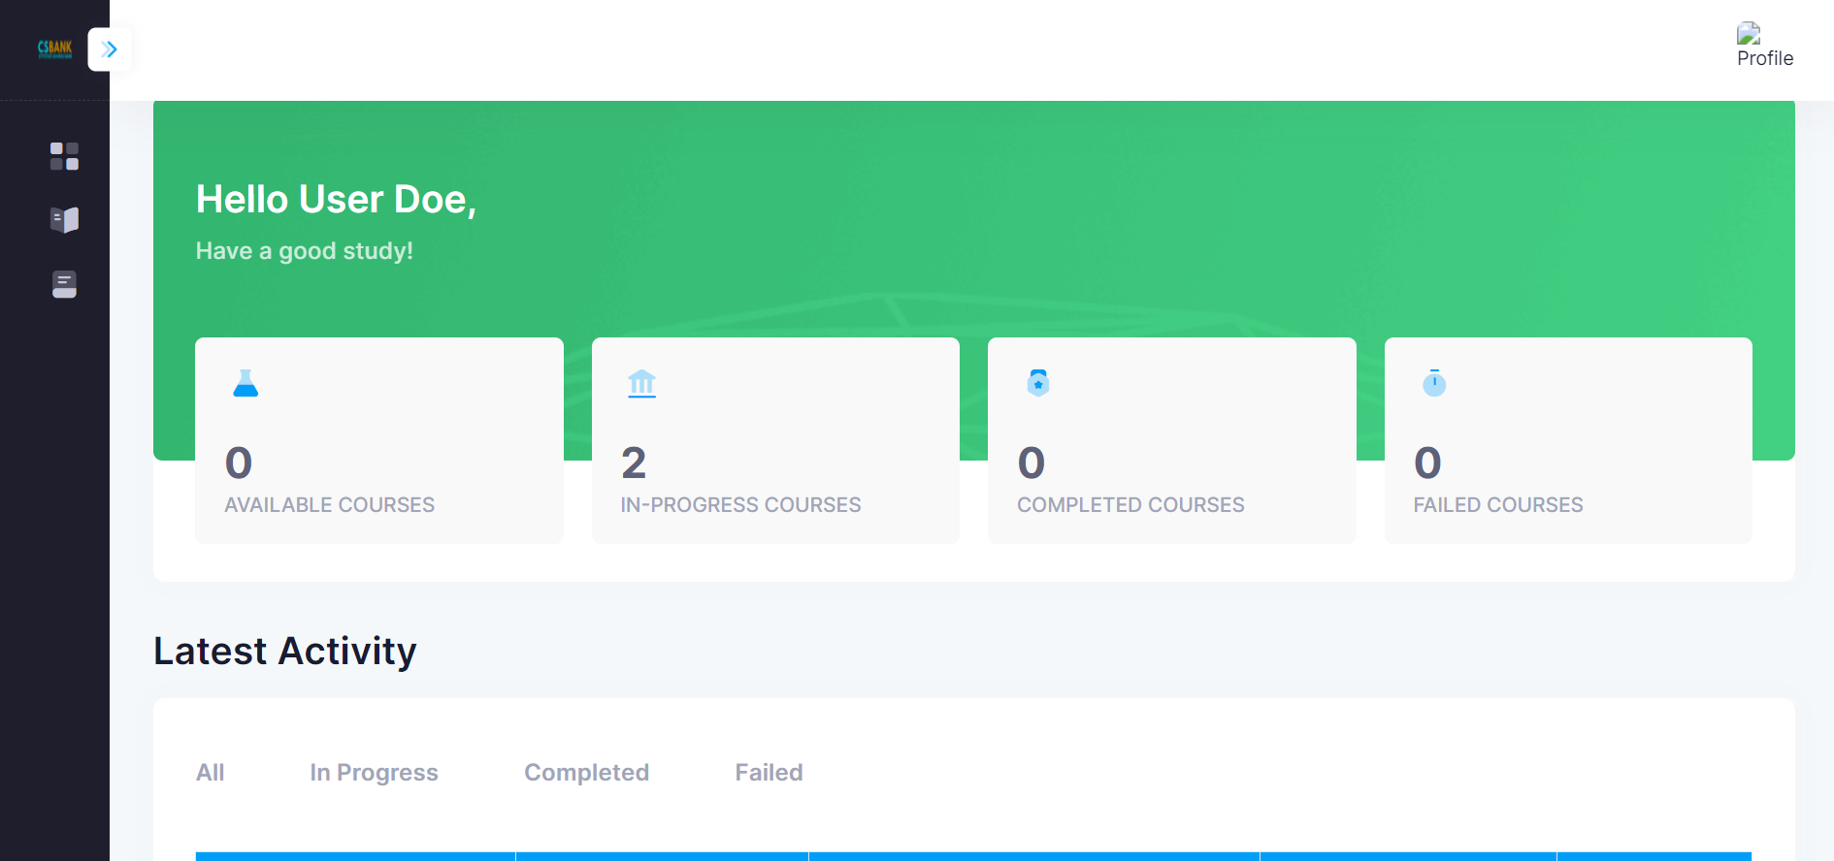
Features | Details | Status
User Dashboard | The User Dashboard aims to give regular users an intuitive interface for accessing courses, and viewing their activity history. | Done

Slide 23
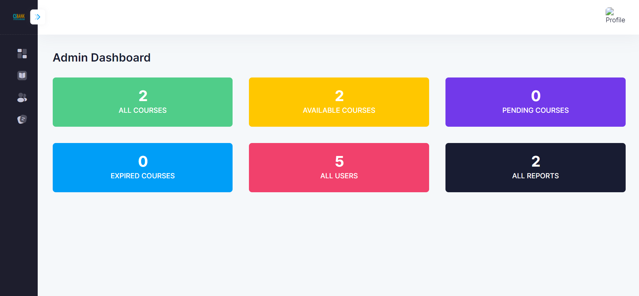
Features | Details | Status
Admin Dashboard | The Admin Dashboard is designed to control for system administrators. It includes user management, course management, and report management. | Done

Slide 24
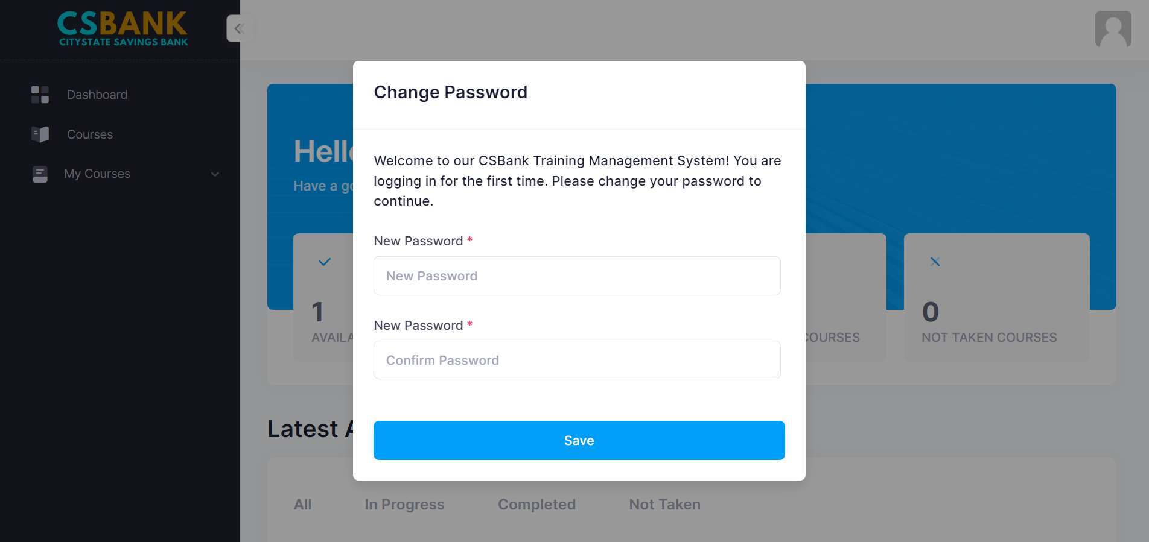
Features | Details | Status
First Time Login (Change Password) | This feature allows user to set a new password during their initial login to the system. | Done

Slide 25
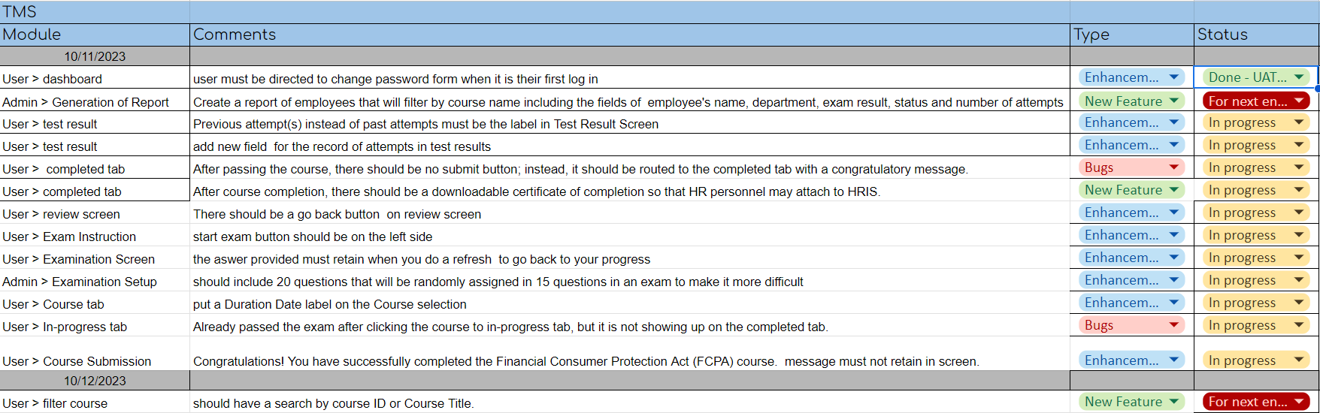
Next Steps – CSBI Training Management System
QA Testing Bug Fix Deploy

Slide 26
Human Resources Information System
Progress Report
Oct 12, 2023

Slide 27
HRIS Progress Report
Task | Details | Problem Encountered | Solution | Status
Data finalization | Uploading and encoding of data |  |  | WIP (List of newly hired and updated regularization dates)
System Tutorial | IT with HR |  |  | Not Started

Slide 28
Payroll Progress Report
Task | Details | Problem Encountered | Status
Initial Payroll Processing | Calculating and combining compensation, benefit and deductions in one table. UI – Display correct records and fields | Calculations and data mapping | WIP - Development Paused
Re-process Payroll | Re-process payroll if any updates have been made before approval. UI – Display correct records and fields |  | WIP - Stopped
Individual Payroll Details | Update employee’s payroll UI – Display correct records and fields |  | NS

Slide 29
In-house Projects Status Report
Conducting a test in TMS to improve and test the capabilities and functionality of the system.
Currently uploading the HR’s requirements to prepare in deployment of HRIS

